Slide 1



STR Aggregator

Slide 2
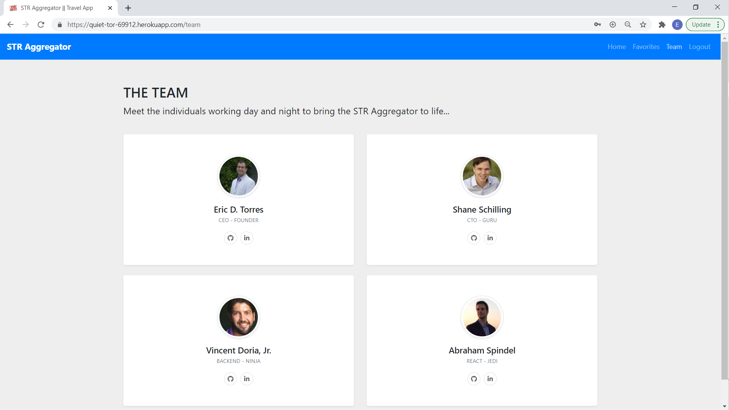
STR Aggregator - TEAM

Slide 3
STR Aggregator-TECHNOLOGIES
Root File (dev server) –
Axios
Bcrypt
Cheerio
Compression
Conurrently
Dotenv
Express
If-env
Jsdom
Mongoose
Morgan
Nodemon
Passport
puppeteer
Client file (react.js) –
Bootstrap
Chart.js
React
React-bootstrap
React Chart.js 2
React-dom
React-router-dom
React-Scripts

Slide 4
STR-Aggregator - FEATURES
React Router for multiple-page SPA
User Authentication
Web Scrapers
MongoDB
Favorites
Travel Budget Creator

Slide 5
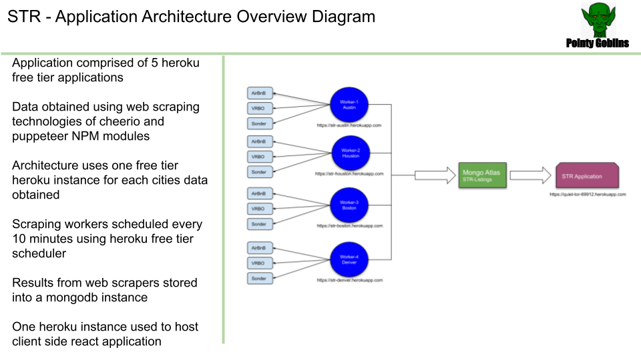

Slide 6

STR Aggregator - DEMO
Take it away, Demo MAN!!

Slide 7
STR Aggregator - Improvements
Need a better name
Code refactor – no controller; happens in the routes (Created much confusion at the end…)
Advanced dynamic funcitonality –
Search
Filter
Highlighting the name of the page in the NavBar to show which page User is currently viewing
Budget page calculates total on Unit Cost and not Total Cost

Slide 8

STR Aggregator - QUESTIONS

